Slide 1
EGCON-2018
National Conference on Prospects and Retrospect in Engineering Geology, Geophysics and Instrumentation GSI,
Hyderabad 3rd – 5th December, 2018
Organised by ISEG & GSI

Slide 2
Polavaram Irrigation Project
By
B. Ajaya Kumar
Director(G)
Engineering Geology Division
Geological Survey of India
Southern Region
Hyderabad

Slide 3
Polavaram Irrigation Project Model
SADDLE DAM
SPILLWAY
PPOWER HOUSE
ECRF DAM
TWIN TUNNELS
NAV & IRRGATION TUNNELS
POLAVARAM
NAVIGATION CANAL
LEFT CANAL
RIGHT CANAL
PURUSHOTTAPATNAM

Slide 4
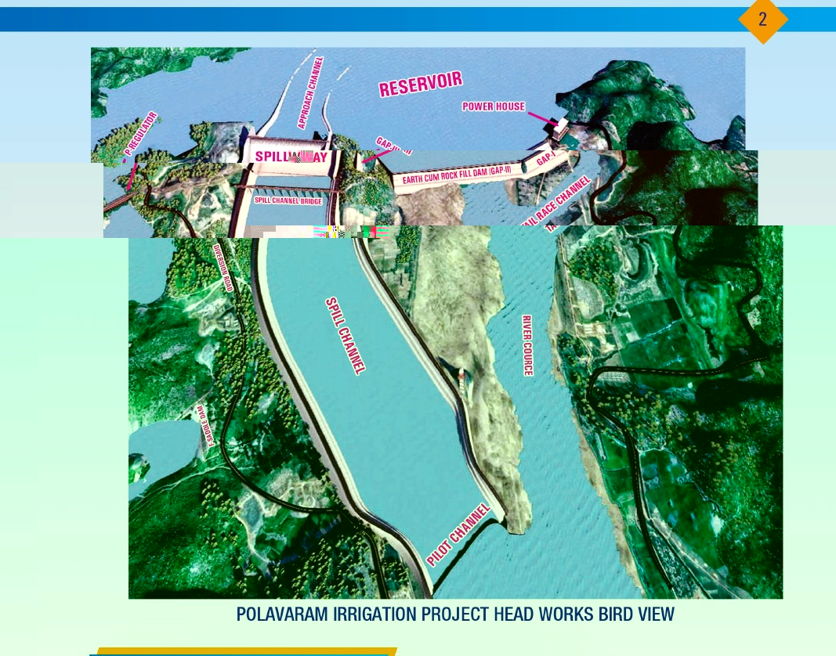

Slide 5
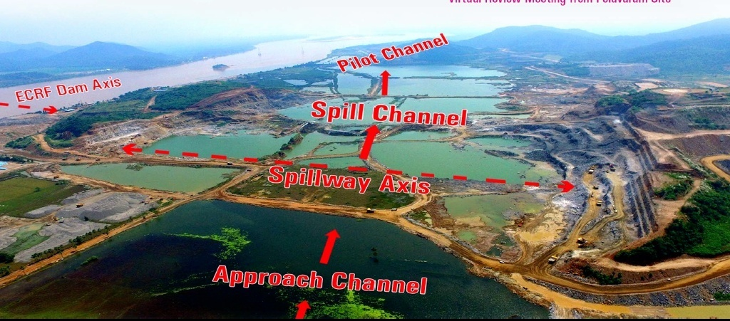

Slide 6
Polavaram Irrigation Project
The Polavaram Irrigation Project is located on the River Godavari area near Ramayyapeta village, Polavaram Mandal, West Godavari District, Andhra Pradesh. The project envisages formation of reservoir across the River Godavari with a live storage capacity of 75.20 TMC.
The project contemplates construction of earth cum rock fill dam (1750m long, 45.08 height), earth dam (560m long , 15m height) and earth dam (130m long, 10m height saddle dam), a 1054.40m long 48 radial gated spillway in the right flank (discharge of 36 lakhs Cusecs) and a surface power house (960 MW; 12 X 80MW) in the left flank.
The project is used for providing water supply for irrigation of 1.62 Lakhs Ha in East Godavari District, Visakhapatnam District by Left Canal connectivity (174km long canal, 17,500 cusecs discharge ) and for irrigation facilities for 1.29 Lakhs Ha in West Godavari district, Krishna district by Right connectivity (181.5km long canal, 17,500 cusecs discharge ) .
Apart from the above, the project also generate 960 MW Hydro Electric Power.

Slide 7
Polavaram Irrigation Project

Slide 8
As an integral part of the project, the construction stage geotechnical investigations were carried out for the foundations of spillway blocks.
The proposed spillway axis is aligned in N74°W-S74°E direction and the saddle portion between a’ and b’ hills is occupied by flood plain back swamp deposits of black silty clays from Ch. 450m to 750m along the spillway axis.
The rocks exposed on the both flanks belonging to Khondalitic suite of rocks, trending in ENE-WSW direction, of Eastern Ghat Mobile Belt of Archaean age.

Slide 9
Salient Features of spillway
Length of the Spillway : 1054.40m
Full Reservoir level : + 45.72 m
Crest level : +25.72 m
Coefficient of discharge : 2.056
Number of gates (vents) : 48 radial gates.
Size of vents : 16m X 20m
Max. Flood discharge : 36 lakhs cusecs
Probable max flood : 50 lakhs cusecs
Max. tail water level : +31.660m
Road level : +54.00m
Stilling basin floor level : +5.40m
Flood disposal level : +44.20m (50lakh cusecs) + 40.72m(36lakh cusecs)

Slide 10
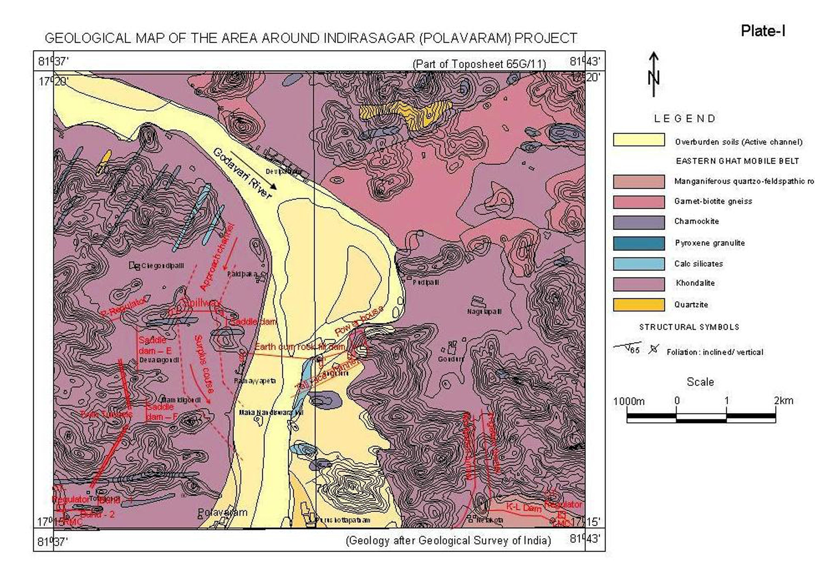
Geological map of Polavaram Irrigation Project site

Slide 11
Progressive construction of spillway in the right flank side

Slide 12
Excavations of foundations of body wall portions of spillway block Polavaram Irrigation Project

Slide 13
Shear zone treatment in the d/s of body wall portion of spillway Block

Slide 14
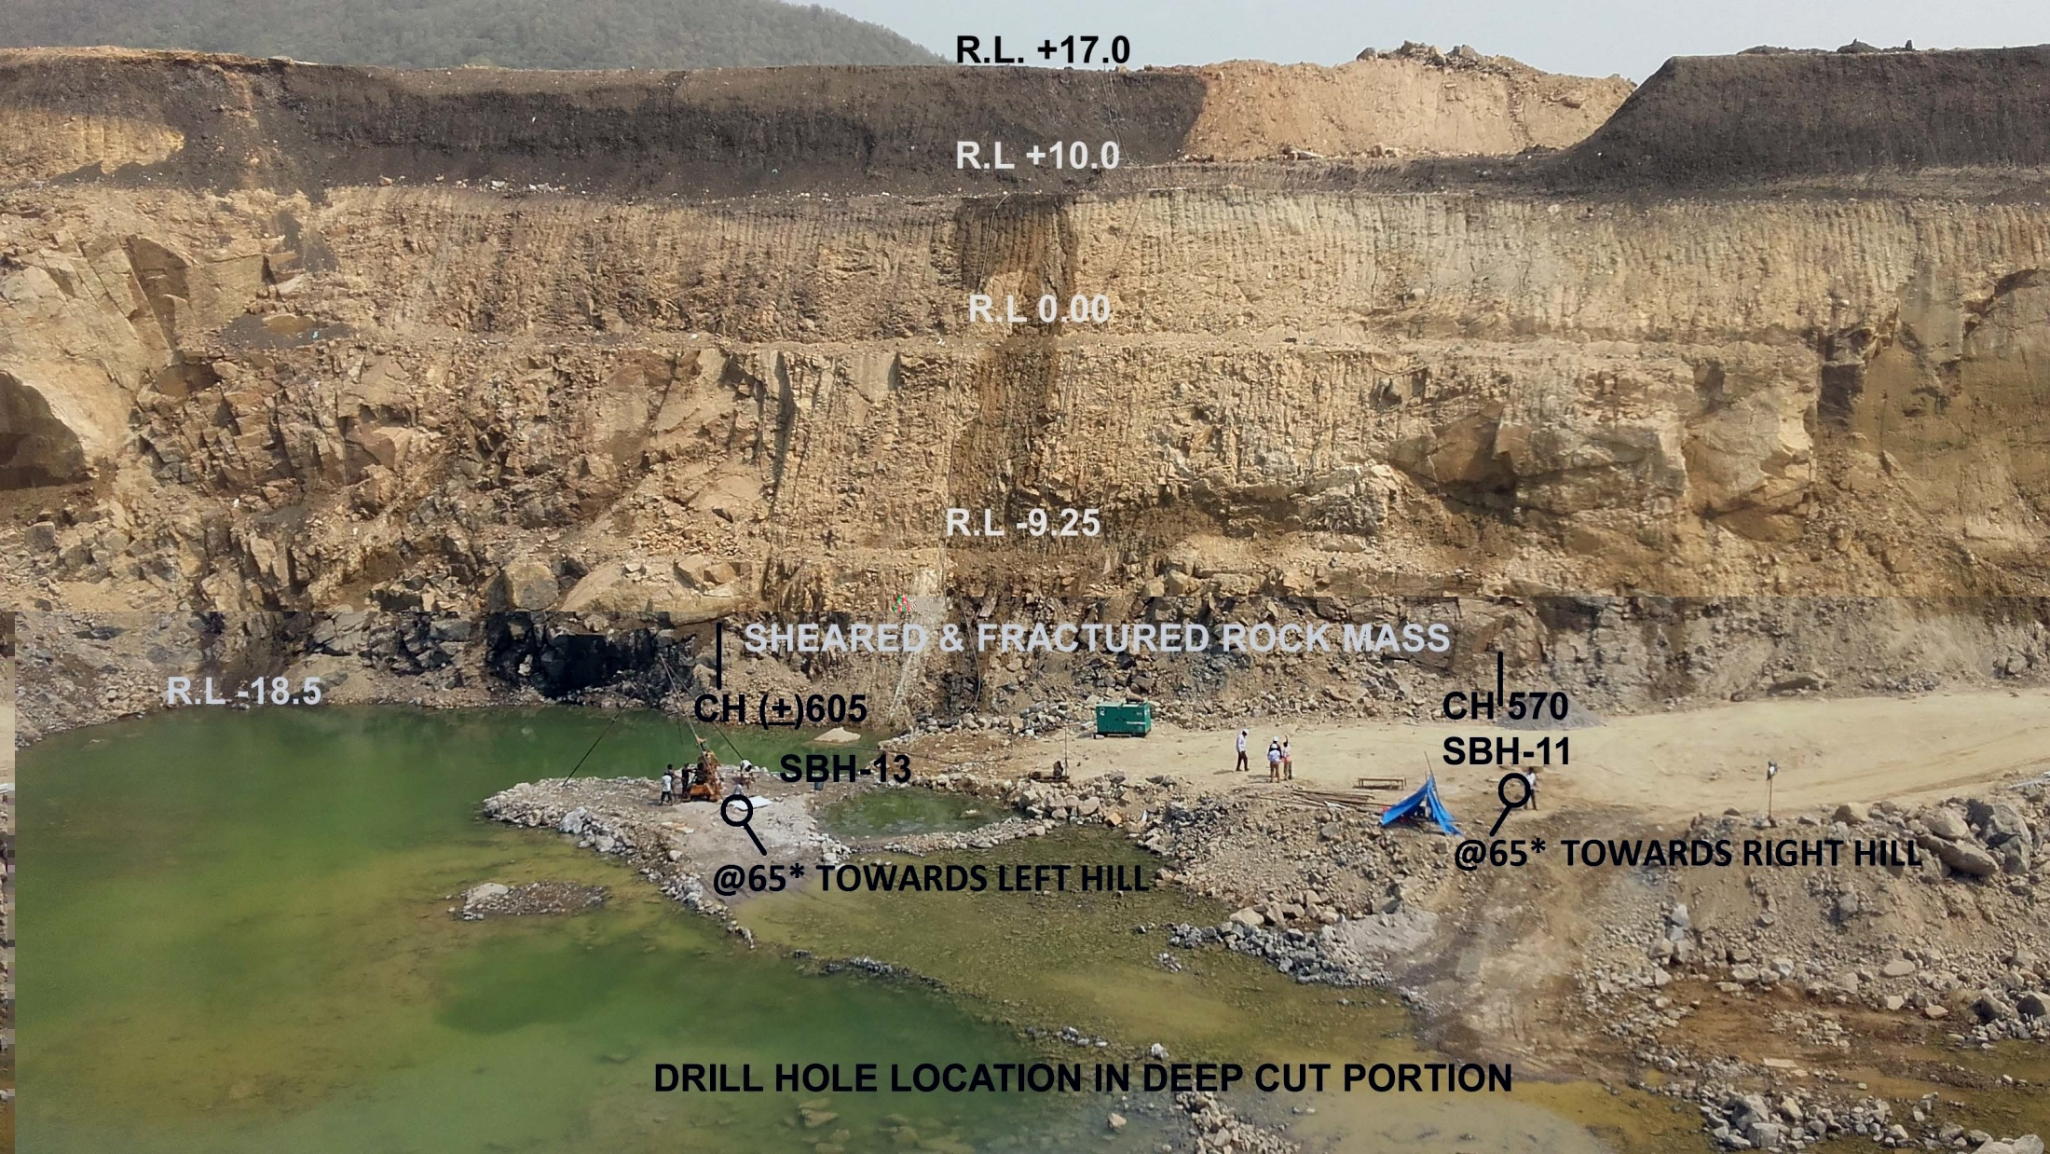

Slide 15
Deep cut portion of the spillway

Slide 16
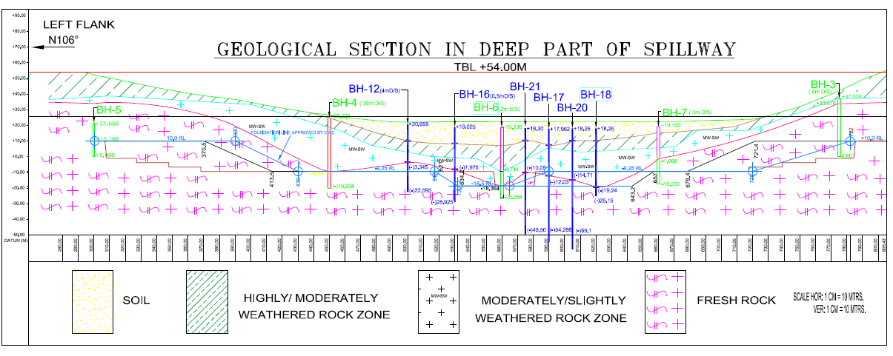

Slide 17
Geotechnical Assessment of foundations of spillway blocks
The rocks exposed at the foundation grade of spillway blocks are fairly fresh to fresh, hard, and vertical to sub vertically foliated garnetiferous quartzo-feldspathic gneiss and bodies of charnockite.
The general foliation trends in N55˚ to 65˚E – S55˚ to 65˚W direction with sub vertical to vertical dips. The foundation levels vary from +9.010m to +10.09m in the body wall portions and stilling basin portions +4.010m to 4.100m. In the deeper section blocks the excavated levels varies from -19.000m to -19.040m and the slope blocks having the excavated levels ranging from -9.050m to -9.452m. The rock mass is traversed by two prominent sets of joints apart from foliation joint and a sub horizantal joint.
The prominent joints recorded are 1.N25-30º E to S25-30°W/ SV to vertical dips, 2. N55º to 65ºE to S55º- 65ºW/vertical to sub vertical dips. The joints are in general tight to slightly open, moderately close to widely spaced, continuous to discontinue in nature.

Slide 18
Plate load tests were conducted by CSMRS, New Delhi along dam axis in the body wall portion of spillway foundations at Ch. 60.967m (RL.10.14m); Ch. 99.226m (RL.9.567m); Ch. 199.120m (RL.10.215m); Ch.310.120m (RL.10.313m); Ch.349.090m (RL.10.345m); Ch.380.738m (RL 10.23m) and all the test results have indicated a value of 250 T/m² against design load of 160T/m².
Permeability tests were also conducted at Ch. 150m (RL. 9.386m) along the dam axis upto a depth of 15.3m below excavated level(+10m). The test results have indicated higher Lugeons values ranging from 16.4Lu to 7.4 Lu in the depth section of 3.3m to 9.3m whereas in the next three meter depth between 9.3m and 12.3m depths shows 2 to 4Lu. In the final depth section between depths 12.3m and 15.3m, the Lu value decreases to zero.

Slide 19
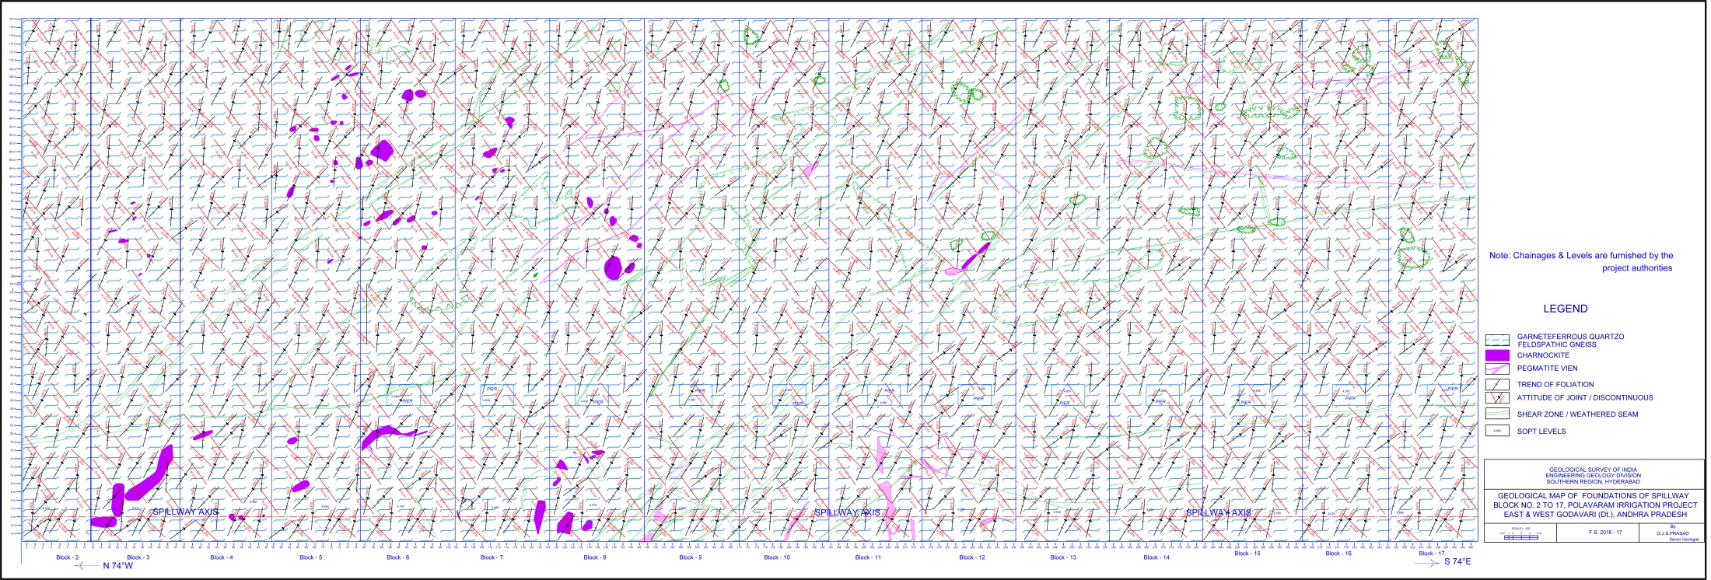
GEOLOGICAL MAP OF FOUNDATIONS OF SPILLWAY BLOCK No. 2 TO 17,
POLAVARAM IRRIGATION PROJECT
EAST & WEST GODAVARI ( Dt.), ANDHRA PRADESH

Slide 20
GEOLOGICAL MAP OF FOUNDATIONS OF SPILLWAY BLOCK No.18 TO 34,
POLAVARAM IRRIGATION PROJECT
EAST & WEST GODAVARI ( Dt.), ANDHRA PRADESH

Slide 21
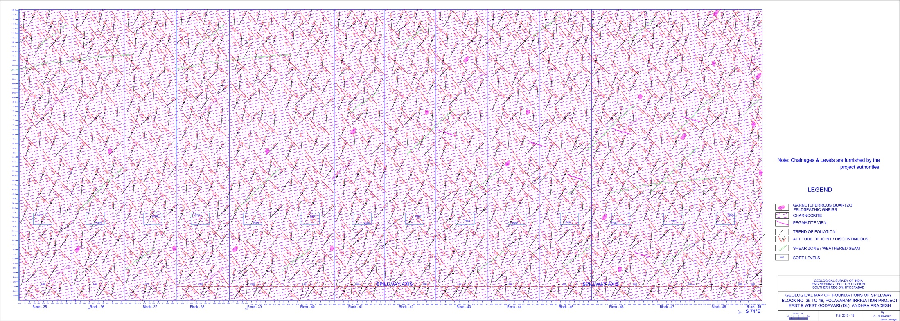
GEOLOGICAL MAP OF FOUNDATIONS OF SPILLWAY BLOCK No. 35 TO 49,
POLAVARAM IRRIGATION PROJECT
EAST & WEST GODAVARI ( Dt.), ANDHRA PRADESH

Slide 22
Suggestions:
For final preparation of foundations, it was suggested to:
remove rock fragments and muck present on the foundations.
eliminate the overhangs as explained and marked at the site.
scoop out/excavate the crushed/weathered material present along the shear zone as per formula treatment as discussed and shown at the site. In the block no 28(part) and 29 (part) excavate the crushed present all along shear zone upto a depth of 1.5m depth as per formula treatment as discussed and shown at the site and also provide reinforcement all along the shear zone. And suggested to provide a 1.5m depth groove/key trench with reinforcement both u/s and d/s side of the shear zone for a horizontal length of 5m.
clean the entire foundations with air-water jet before placing the leveling course.
carry out the consolidation grouting (B- holes) as per designs for the foundations by drilling 12m deep grout holes spaced at 3m c/c staggered pattern. Provide additional grout holes all along the shear zone upto depth of 15m.
provide reinforcement for weathered seams/ shear zones as shown and marked at site.

Slide 23
Suggestions:
chisel the yellowish coating on foundations/joint surfaces to become rugged surface and clean the entire foundations with air-water jet before placing the leveling course.
carry out the consolidation grouting (B- holes) as per designs for the foundations by drilling 8m deep grout holes spaced at 3m c/c staggered pattern in the body wall portion and carry out the consolidation grouting for the foundations by drilling 6m deep grout holes spaced at 6m c/c staggered pattern in the stilling basin portions
provide additional grout holes all along the shear zone as shown at site with 3m interval and upto a depth of 9m and 15m along the shear zone in 28 and 29 blocks..
carry out curtain grouting (A-holes) along the central line of the spillway structure upto a depth of 38m and the spacing of the holes will be maintained as mentioned in the design drawings.
conduct post-grout permeability tests in body wall portions of every block to know the efficacy of grouting and for further evaluation. carry out anchorage as per approved designs for the slopes of the foundations and also for stilling basin portions.

Slide 27
Thank you

